Slide 1
Your Professionals’ Assistance Program
Presenter: Natacha Riopel
Sales Director and Account Executive – Atlantic Canada
Homewood Health
Notes:
MANDATORY

Slide 2
Agenda
About Homewood Health™
Your assistance program
Counselling
Life Smart Coaching
Homeweb.ca
Confidentiality
Accessing services
Notes:
MANDATORY

Slide 3
Who are we?
A trusted Canadian company, providing services to clients like you since 1979.
An independent provider to ensure confidentiality.
Expertise in mental health and addictions since 1886
Notes:
MANDATORY

Slide 4
Highlights
Accessible toll-free 24 hours a day, 7 days a week, 365 days a year
In person, telephone, video, online (self-register at homeweb.ca)
Book an appointment or access help right away, including crisis support
Multi-cultural and multi-lingual
For members, employees, spouse/partner, eligible dependents
Your legal support staff is also covered
Participation is voluntary
Private and confidential
No cost to the user
Notes:
MANDATORY

Slide 5
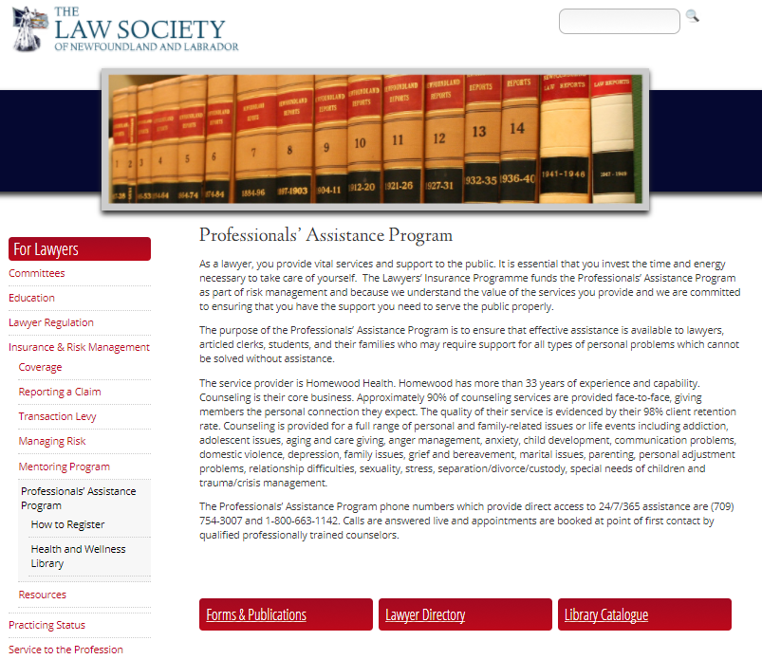
More information

Slide 6
When should you call your assistance program?
Notes:
OPTIONAL – time permitting

Slide 7
We can help with:
A wide variety of situations:
Stress, anxiety, depression
Life change and transitions
Relationship concerns
Family and parenting challenges
Child care coaching and resources
Elder care coaching and resources
Grief or bereavement
Alcohol, drug, gambling, smoking issues
Legal concerns
Financial worries
Medical or health-related information
Career development
Healthy lifestyle changes
Notes:
OPTIONAL – time permitting

Slide 8
Full Suite of Services
Counselling
Face-to-face
Telephonic
Video
Online
(email or chat formats)
Life Smart Coaching
Life Balance Solutions
Health Smart Coaching
Career Smart Coaching
Online Resources
Homeweb.ca
Online Courses
Child and Elder Care Locators
Health Risk Assessment
Notes:
MANDATORY

Slide 9
Life Smart Coaching
Notes:
MANDATORY

Slide 10
Life Smart Coaching
Practical and proactive resources that help individuals with every day issues
Telephonic assessment of needs by a specialist.
Information and supportive coaching from an expert in the field.
Customized searches for relevant resources.
Up-to-date and tailored information including:
topical workbooks
current articles
referral to online tools and resources
Notes:
MANDATORY
10

Slide 11
Life Balance Solutions
Notes:
MANDATORY

Slide 12
New Parent Support
Coaching and information on what to expect and how to succeed as a new parent.
Expert information/advice from a parenting specialist
Package of information tailored for specific needs
Post-delivery support
Notes:
MANDATORY
12

Slide 13
Childcare and Parenting and Parenting
Support for parents who face parenting or family challenges.
Consultation with a childcare specialist
Customized resources to match the need:
Child or daycare facilities
Adoption services
Special needs/gifted
Summer camps
and much more…
Personalized package with resource information, as needed
Notes:
MANDATORY
13

Slide 14
Elder and Family Care
Support for people caring for aging parents or loved ones.
Consultation with a elder care specialist
Customized resources to match the need:
Support options
Long-term care facilities
Seniors’ residences
Mobility tools
and much more…
Personalized package with resource information, as needed
Notes:
MANDATORY

Slide 15
Financial Consultation
Helping people enjoy financial peace of mind.
One-on-one consultation with a financial expert
Guidance for a broad range of issues including:
Financial goal setting
Budgeting
Getting out of debt
Establishing or rebuilding credit
Financial challenges resulting from separation/divorce, disability, income loss
Estate and retirement planning
Notes:
MANDATORY

Slide 16
Legal Advisory
Providing consultation and clarification on legal matters.
One-on-one advice/consultation with a lawyer
Guidance on a broad range of issues including:
Family law
Civil litigation
Real estate
Wills and estates
Criminal
Immigration law
Lawyer referrals available
Notes:
MANDATORY

Slide 17
Relationship Solutions
Support for people looking to revitalize their relationship connection.
Self-directed resource
Ideal for couples looking to:
Reignite the flame
Improve communication
Positively deal with conflict
Grow together as a couple
Prepare for cohabitation
Notes:
MANDATORY

Slide 18
Grief and Loss
Grieving can be an overwhelming and complex process.
Self-directed resource
Ideal for individuals looking for help with:
Recently losing of a loved one
Divorce or relationship loss
Job loss
Child grief
Emotional support

Slide 19
Health Smart Coaching
Notes:
MANDATORY

Slide 20
Nutritional Coaching
Helps to improve eating habits and understand how nutrition can positively impact some illnesses.
Registered Dietitians provide:
initial assessment
step-by-step action plan
‘how to’ advice and coaching
Helpful for weight management, eating
for energy, disease state management
Notes:
MANDATORY

Slide 21
Jumpstart your Wellness
Support for people looking to achieve specific health and wellness goals.
Participants receive access to a range of online tools and resources including:
A Readiness for Change questionnaire
Articles
Includes coaching with a behaviour-change consultant with expertise in the ‘goal’ area
Develop new behaviours to create positive and lasting lifestyle, productivity and work life changes
Notes:
MANDATORY

Slide 22
Smoking Cessation
Support for quitting one of the most difficult addictions.
Helps to address:
physical dependence
psychological dependence
foundations of successful behaviour change
Specialists provide coaching incorporating the latest, proven behaviour-change techniques
We help direct you to a comprehensive program of your choice
Notes:
MANDATORY

Slide 23
Career Smart Coaching
Notes:
MANDATORY

Slide 24
Career Coaching
Assists people in identifying and articulating skills, aptitudes, values, personality traits, and interests related to their career.
Depending on individual need, coaching is provided related to career areas, including:
Problem solving and conflict resolution
Change and transition management
Time management
Stress management and work-life balance
Building cooperation with co-workers
Notes:
MANDATORY

Slide 25
Pre-Retirement Planning
Advance planning can help ensure a worry-free retirement.
Specialist complete a comprehensive assessment and provide coaching and strategies linked to the:
psychological
emotional
needs as one approaches retirement.
Notes:
MANDATORY

Slide 26
Shift Worker Support
Assists in making shift work easier and shift workers healthier.
Specialists conduct a full assessment of areas typically affected by working shifts, such as sleep, nutrition and diet, social challenges, home environment, etc.
Coaching, tips, online, and other resources are provided depending on the needs highlighted in the assessment.
Notes:
MANDATORY

Slide 27
Counselling Services
Notes:
MANDATORY

Slide 28
About Counselling
Short-term, solution-focused counselling — a client-centred approach to goal setting and problem solving
Bridging to community services, specialized referrals and treatment, if needed
Professional standards include a minimum of Masters degree and five years experience
Multilingual, diverse clinical network; counsellors are experts across many areas
Notes:
MANDATORY

Slide 29
Online Services
Notes:
MANDATORY

Slide 30
Homeweb.ca
Online Service Locators
Locators for both child and elder
care services
Health & Wellness Resources
Comprehensive suite of online tools to assess health risk and develop improvement plans
Health Risk Assessment (HRA) tool
Health Library
Online Courses
Empowers learners to better manage personal health and expand work-related skill sets
Notes:
MANDATORY

Slide 31
Online Courses
For Employees & Family:
Taking Control of Stress
Taking Control of Anger
Resilience
Taking Control of Your Mood
Foundations of Effective Parenting
Taking Control of Job Loss and Transition
Resolving Conflict in Intimate Relationships
Embracing Workplace Change
Responsible Optimism
Taking Control of Alcohol Use
Taking Control of Your Career
Taking Control of Your Money
Stop Smoking: Get Your Life Back
Preparing For Your Retirement
Respect in the Workplace
For People Leaders:
Leading the Human Side of Change
Values-Based Leadership
Managing Sensitive Employee Issues
Supporting Respect in the Workplace
Fundamentals of Effective Supervision
Notes:
OPTIONAL

Slide 32
New! i-Volve Online CBT
New service included in your assistance program
For mild to moderate symptoms of depression and anxiety
100% web based and self guided
Available 24/7/365 on desktop and mobile devices
Option to add coaching
Available on Homeweb.ca

Slide 33
Privacy and Confidentiality
Our Commitment
Information is confidential
Appointments scheduled for privacy
Private offices are offsite
Clients contact us directly
Phone messages are never left without prior permission
Flexible scheduling
Reports include group data only
Secure record-keeping
No identifying information is transferred to anyone without your known, written consent.
Exceptions are
children at risk,
risk to self or others,
or subpoena.
Notes:
MANDATORY

Slide 34
Information Collected
Our questions are brief and respect confidentiality and privacy.
Name, address, organization, job to determine eligibility and benefit coverage
Immediacy of need
Relationship to employee
if a dependent or family member
General nature of issue
to direct to appropriate counsellor or service
Appointment time/location
Notes:
MANDATORY

Slide 35
Connect to your assistance program
(709) 754-3007
1-800-663-1142 (English)
1-866-398-9505 (French)
1-888-384-1152 (TTY/hearing impaired)
604-689-1717 International (call collect)
homeweb.ca
Notes:
12-13% utilization

